Slide 1

NAVSEA GovApp Store
Prepared By:
Brandon Ung
Maximiliano Barragan
Andrew Aquino
Kevin Parton
Richard Thome
Faculty Advisor:
Jiang Guo

Slide 2
Agenda
About GovApp Store
Objectives and Requirements
Tech Demo
Conclusion

Slide 3
About GovApp Store
Introduction

Slide 4
What is NAVSEA GovApp?
NAVSEA GovApp is website dedicated to providing fast delivery of military applications used by the Navy. The purpose of this project is to provide a powerful application to support the fleet.
The website works similarly to other App stores such as the “Apple Store,” and “Google Play.” Key components in this webstore includes registering, login, downloading, and uploading.

Slide 5
Objectives and Requirements
Understanding the Goals

Slide 6
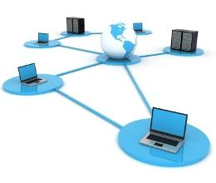
NAVSEA GovApp Store Objectives
Three primary objectives in designing the GovApp Store.
Create a working environment for any remote device to access.
Increase the flexibility of computing systems that can dynamically make adjustments and instantly meet the demands for change.
Decrease the overall maintenance cost by supporting automatic system updates.

Slide 7
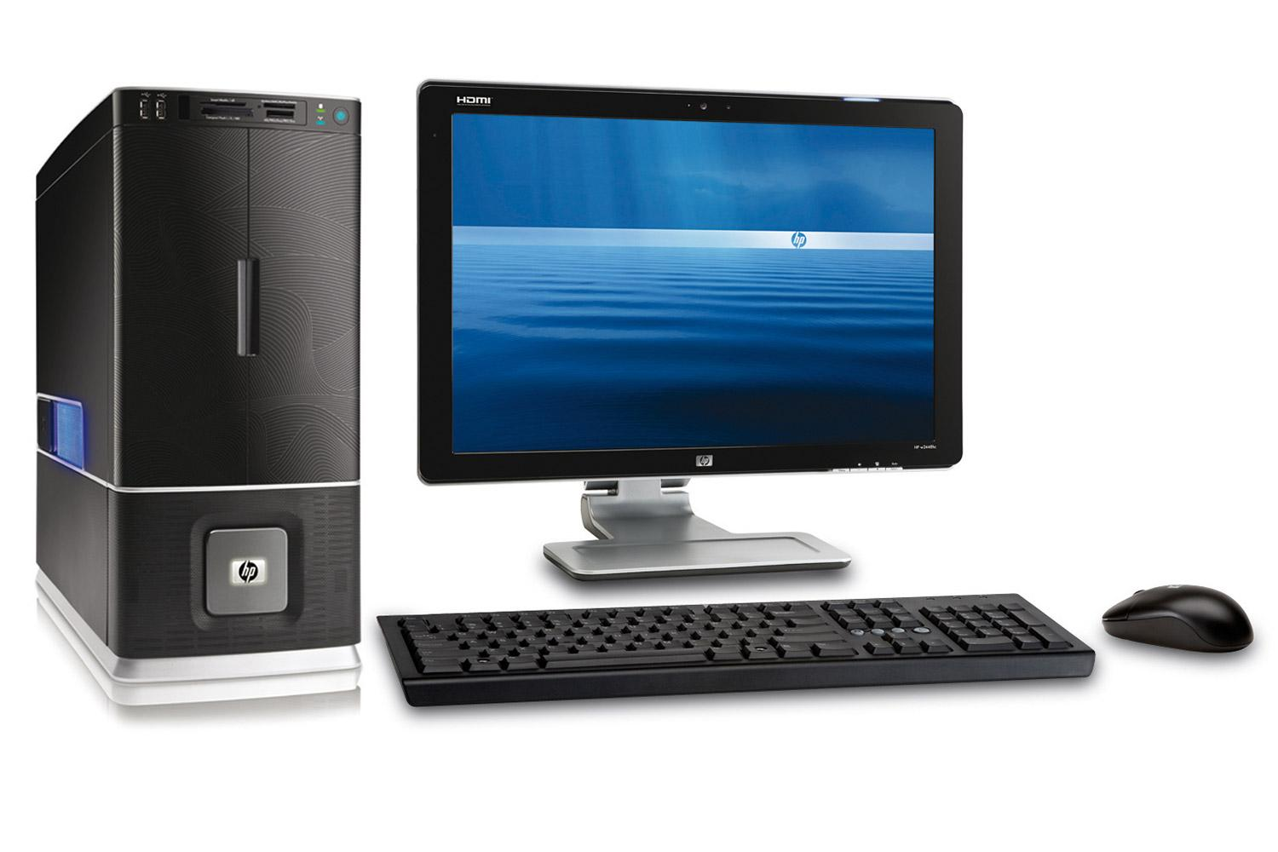
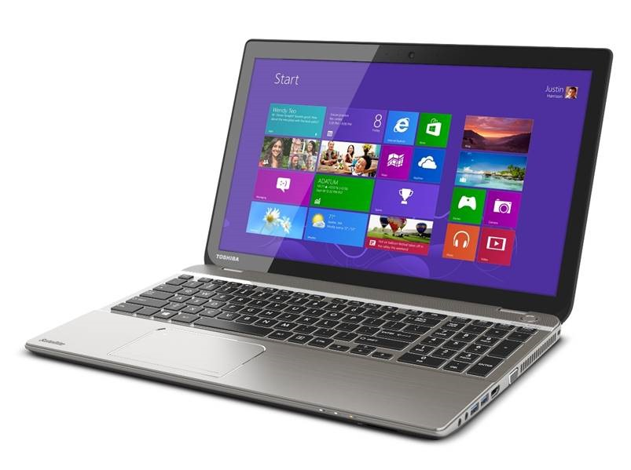
Hardware Requirements
Basic computer setup
Monitor, keyboard and desktop or laptop is required to work with this application.

Slide 8


Operating Environment
The web application applies the following programs:
Node.js and Sails.js for MVC framework and back-end design
Polymer and JQuery for front-end design
MongoDB (or NoSQL) for database

Slide 9

Programming Language - JavaScript
Main Language - JavaScript
Perfect language for web design and application.
Has libraries to fulfill many needs for web design such as Angular.js and Polymer.
Node.js applies a lot of useful packages.
JavaScript is a Prototyping language. Rapid and flexible design.

Slide 10
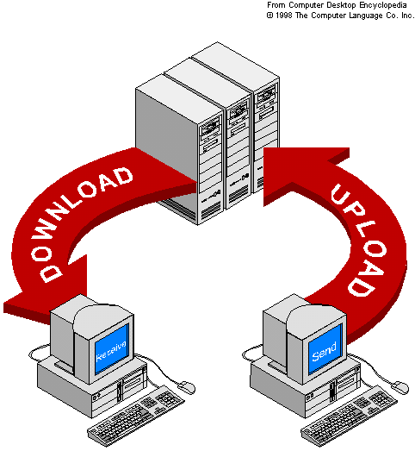
Functional Requirements
Allow users to register and login onto the website.
Homepage should allow the user to use and access: logout, search app, download app, and upload app.
“Search App” query shall allow the user to search for specific apps.
“Download App” page shall allow users to download a specific app.
“Upload App” page shall allow users to upload an app onto the server.

Slide 11
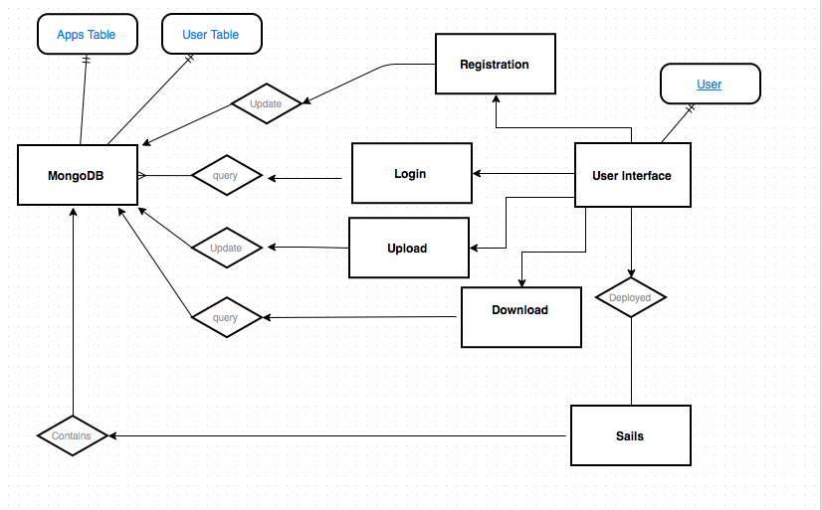

Slide 12
Tech Demo
GovApp Store Demonstration

Slide 13
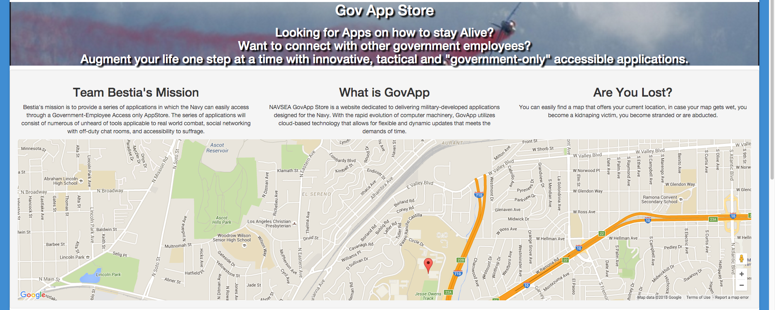
GovApp Store Homepage Page

Slide 14
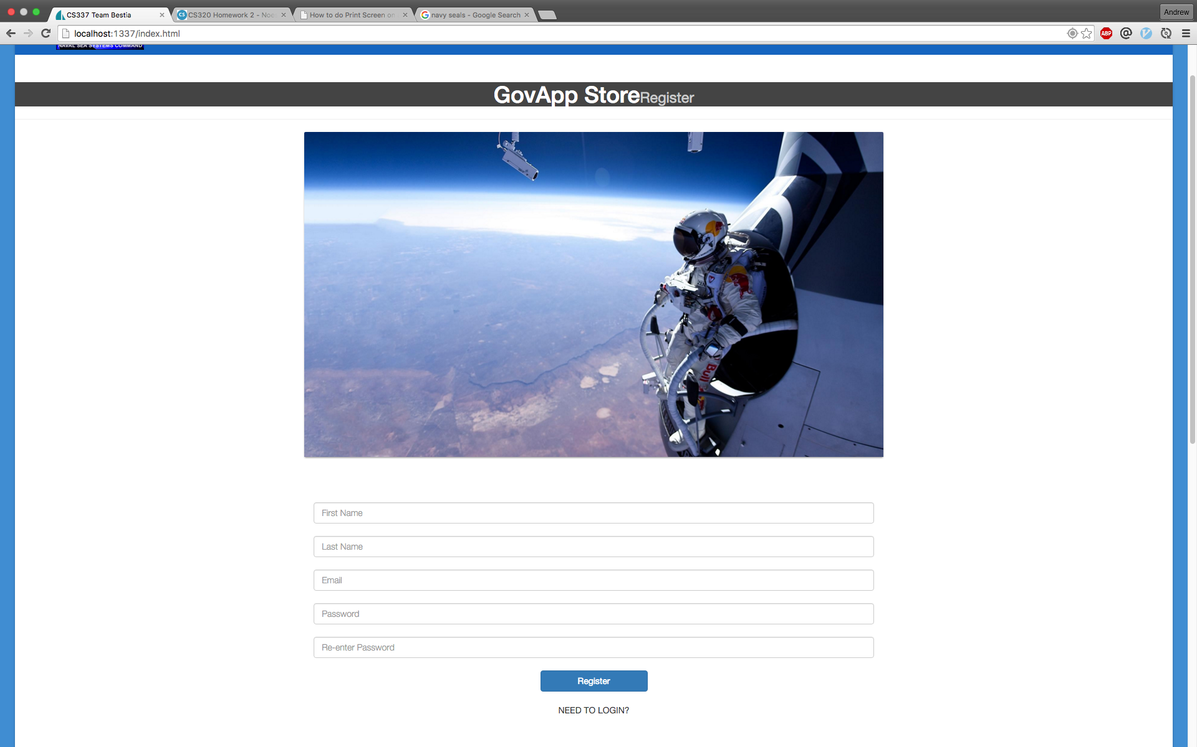
GovApp Store Registration Page

Slide 15
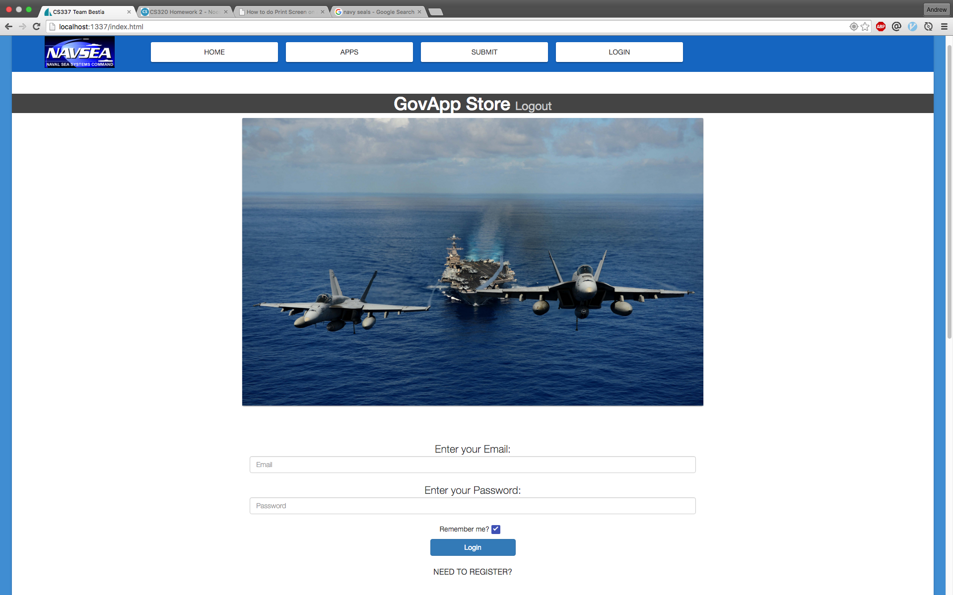
GovApp Store Login Page

Slide 16
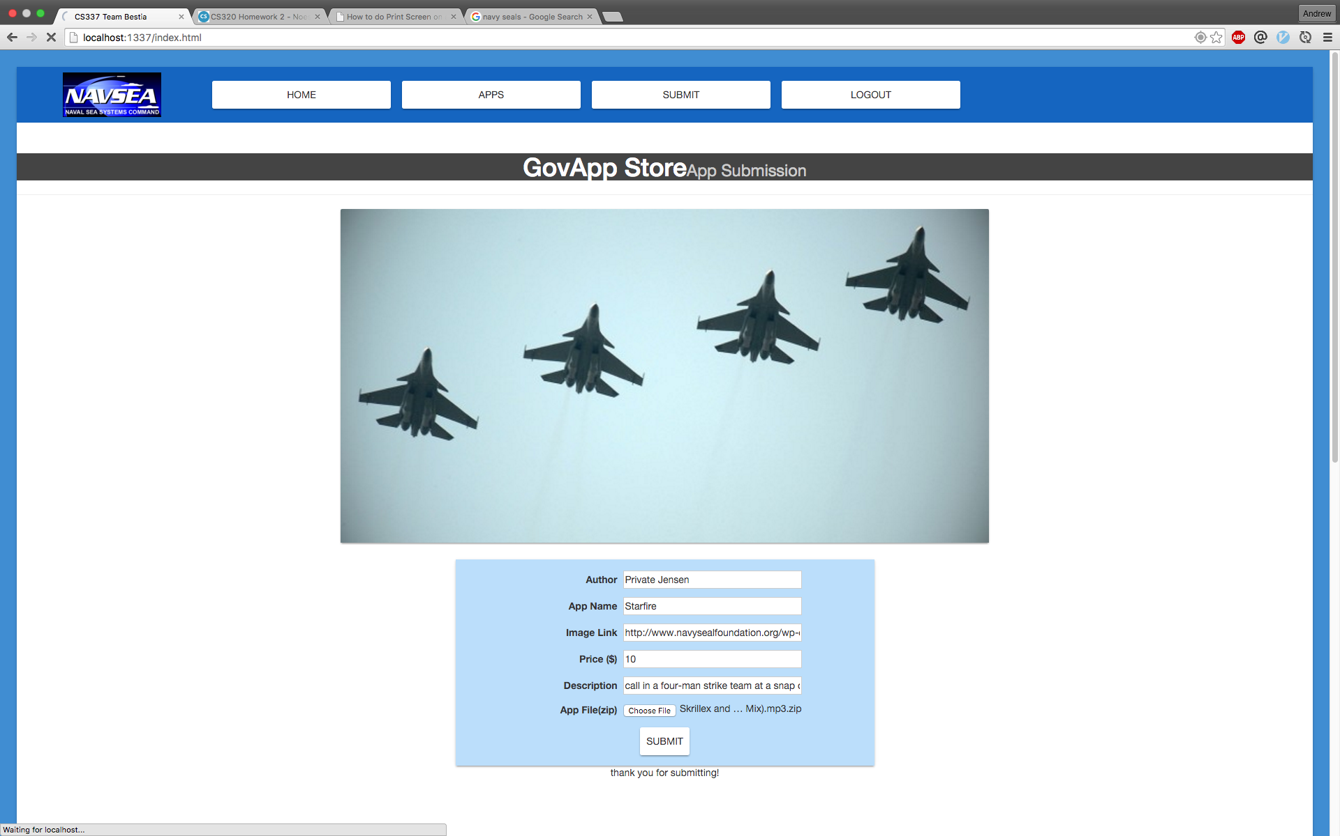
GovApp Store Upload Page

Slide 17
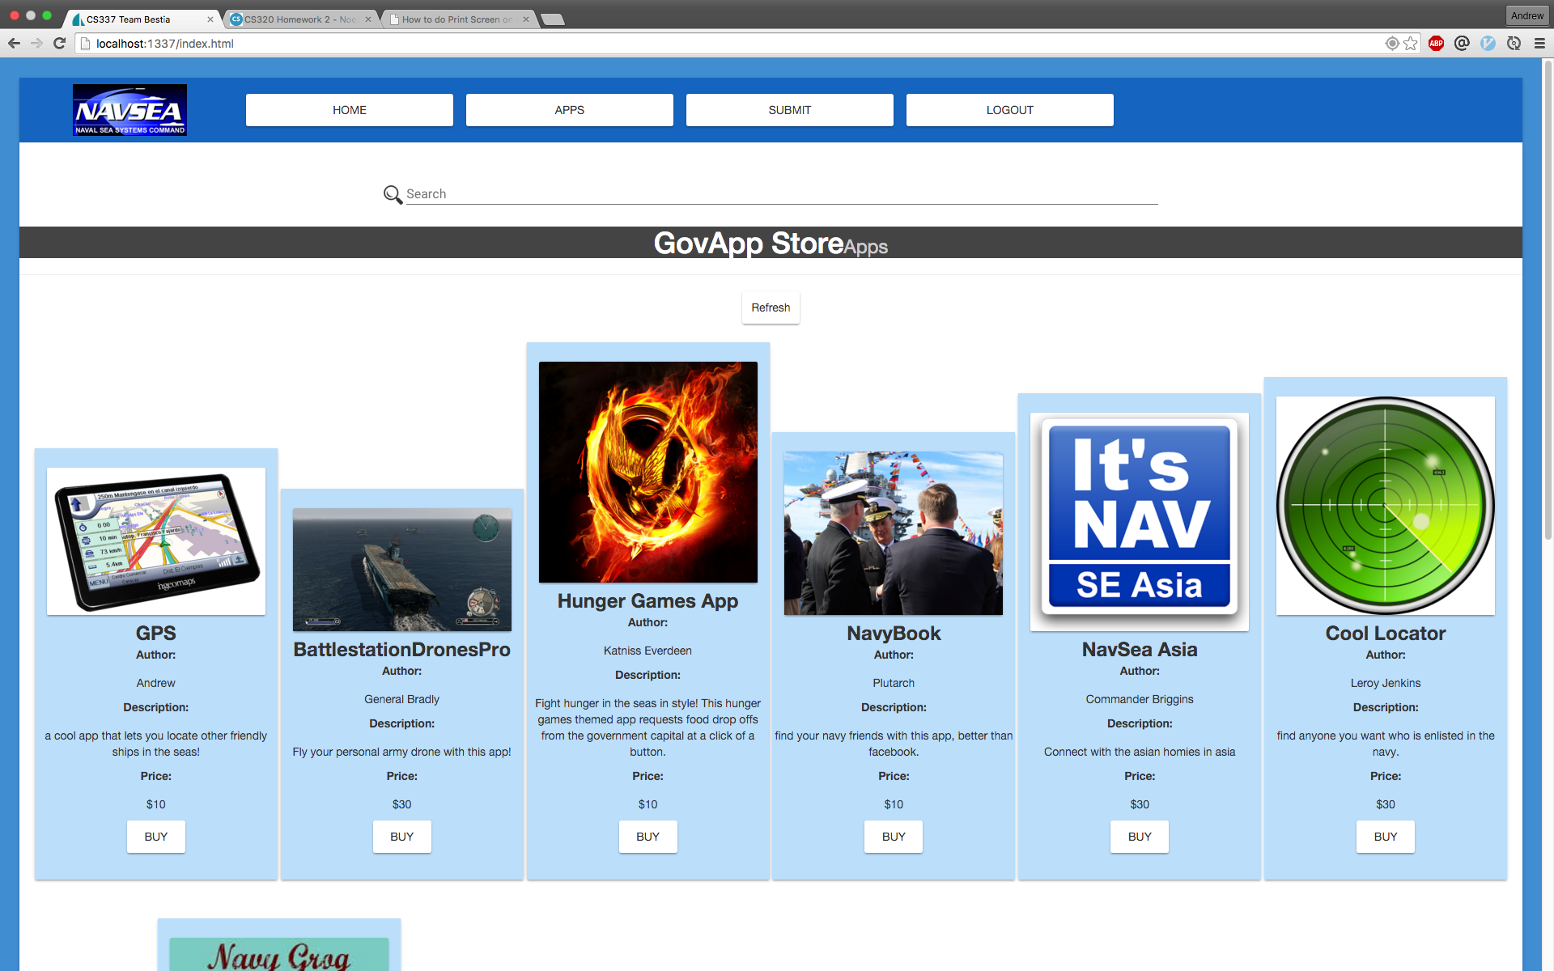
GovApp Apps Page

Slide 18
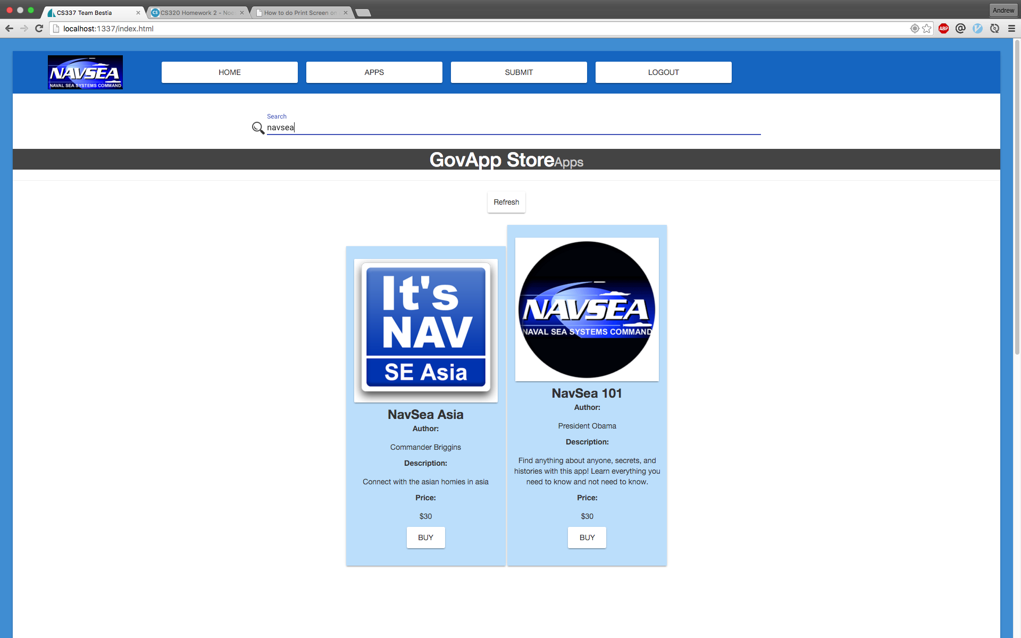
GovApp Apps Page with Search

Slide 19
Conclusion
Overall Work Summary

Slide 20
Challenges in GovApp Store
Setting up the work environment
Windows vs. Mac
Understanding the primary functions of the GovApp Store
Modulating each function
Understanding the existing libraries
JQuery
Polymer
NodeJs
Being consistently updated on the documentation

